Slide 1


Slide 2



Slide 3
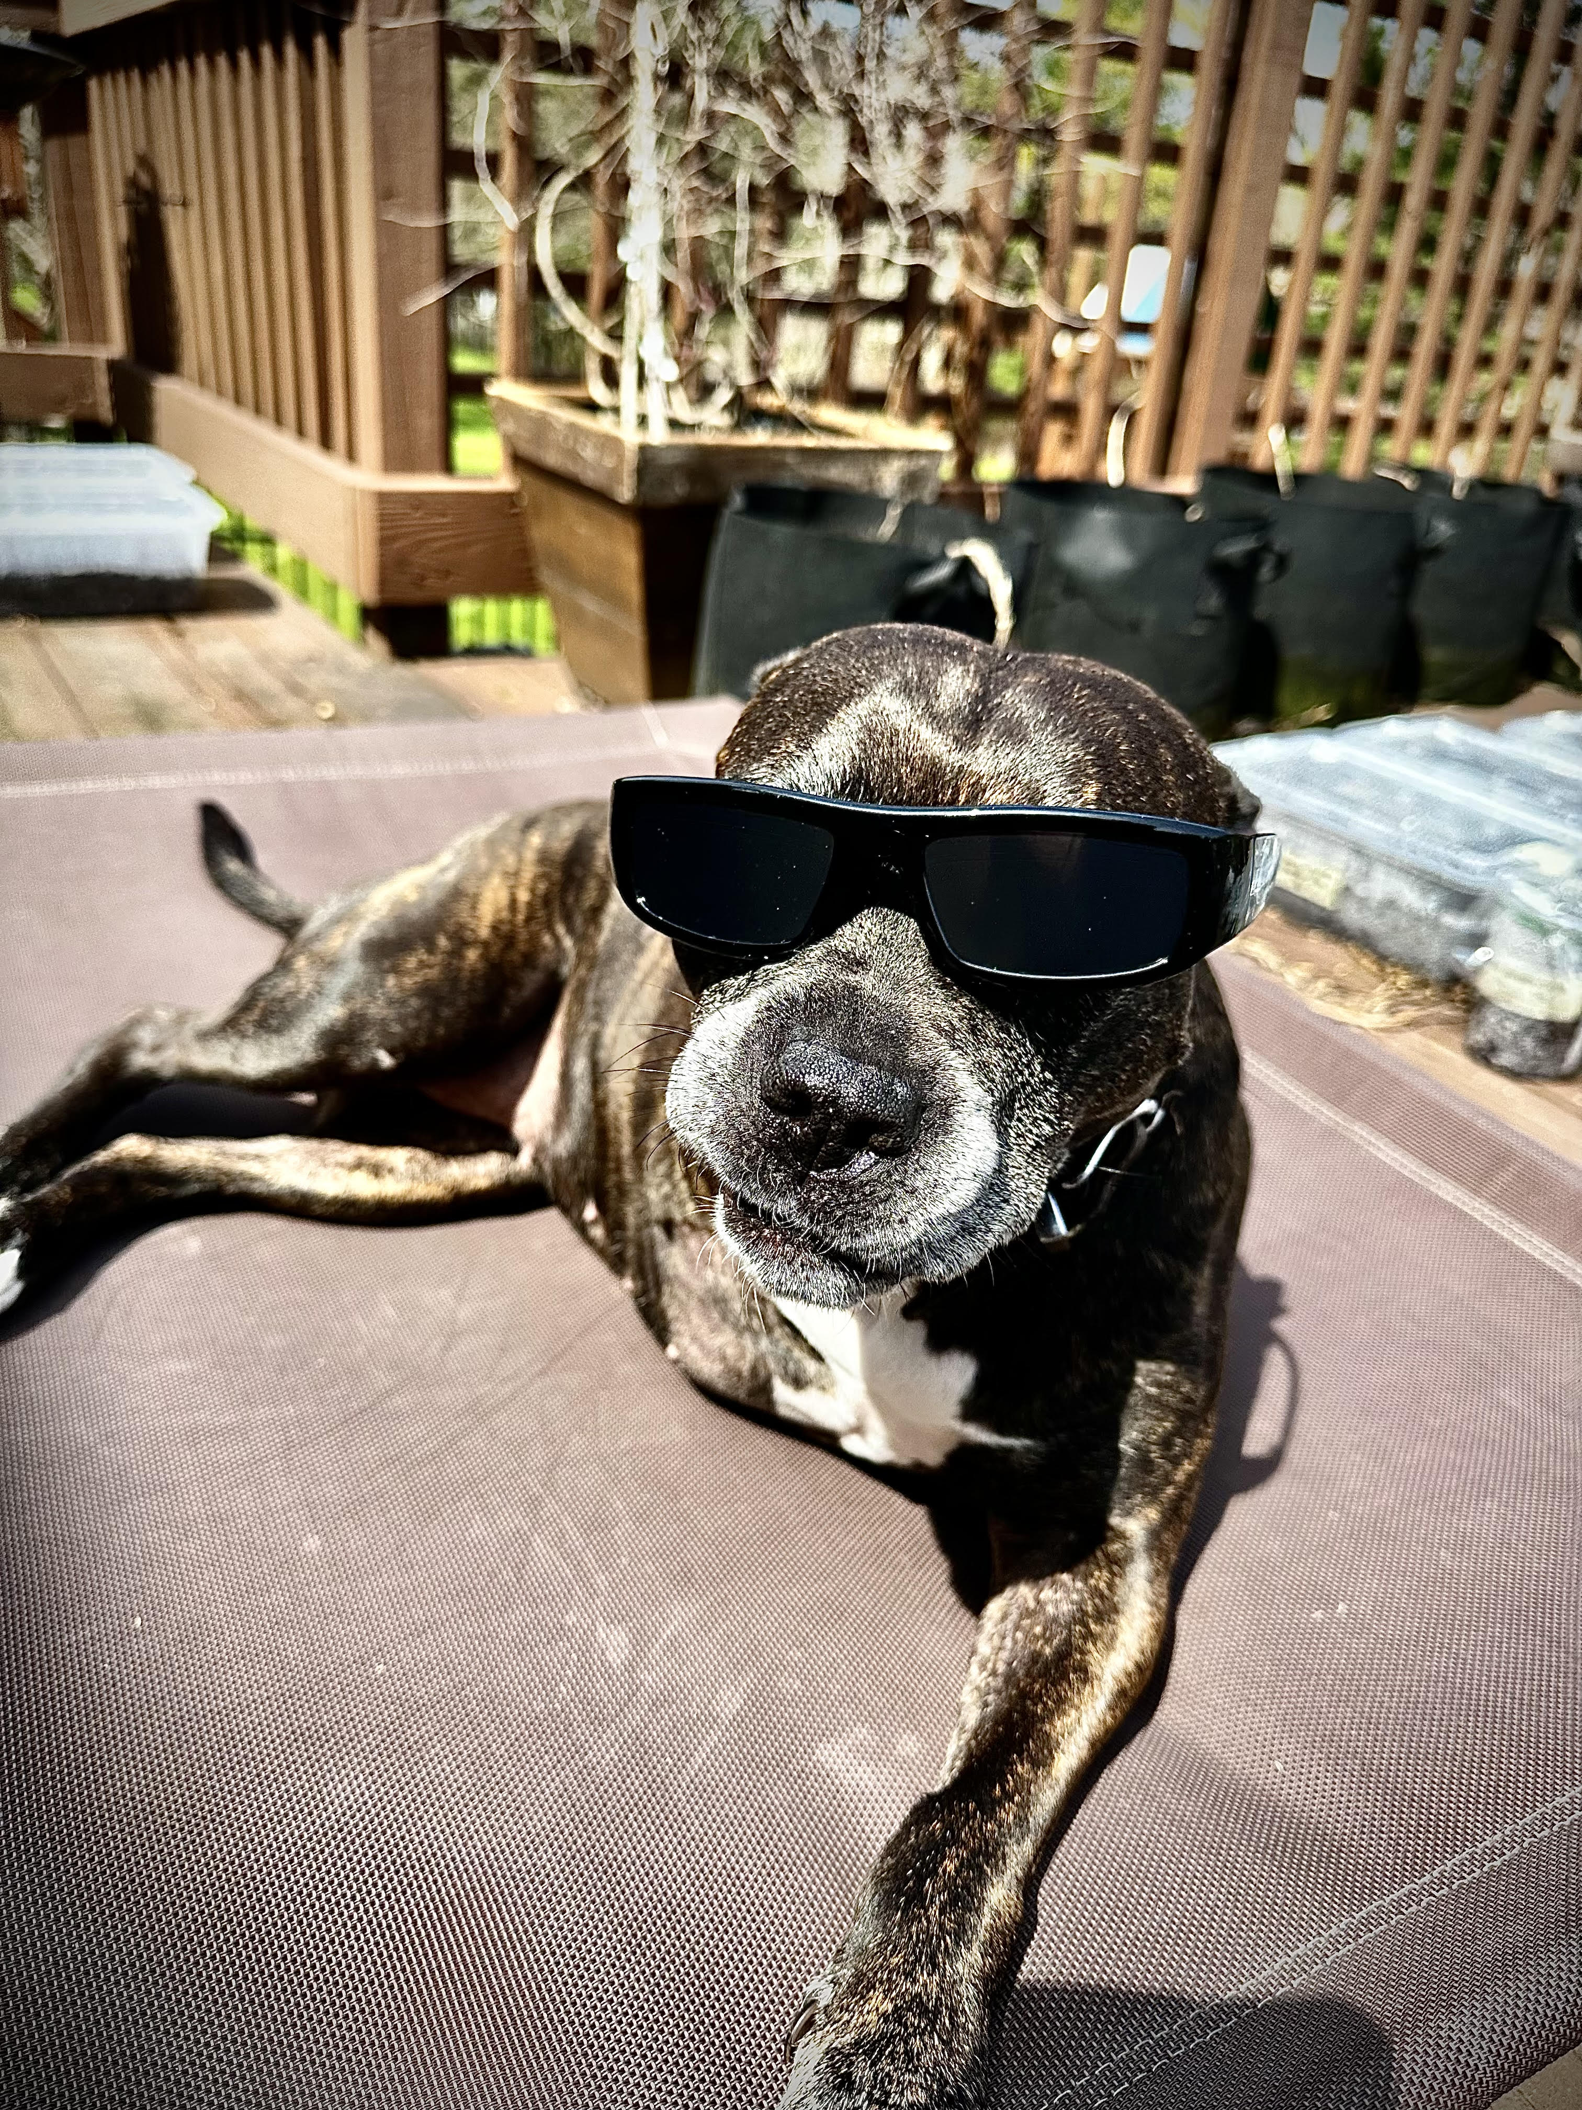
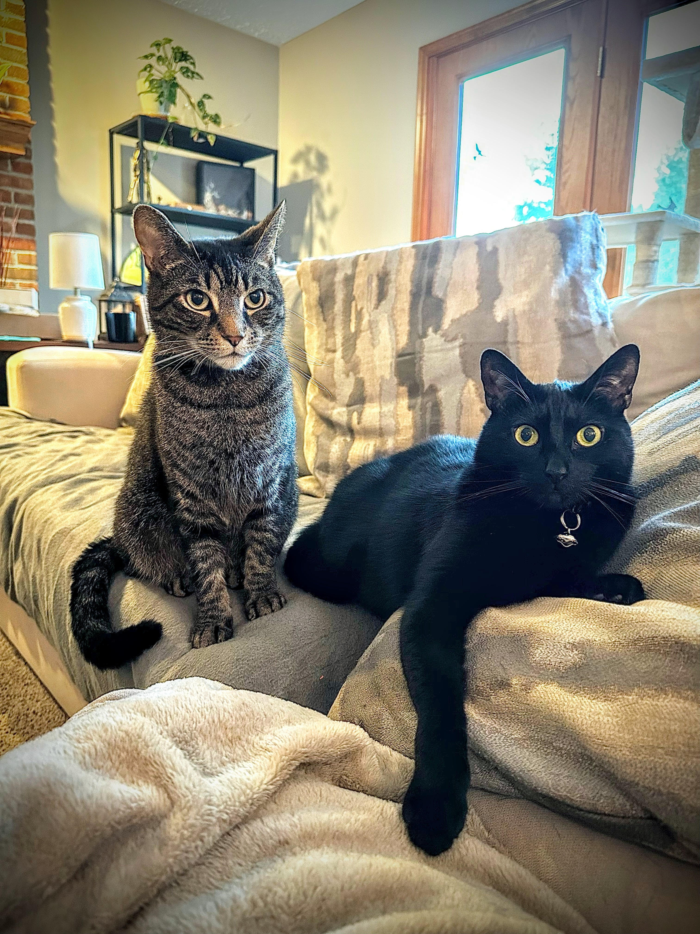
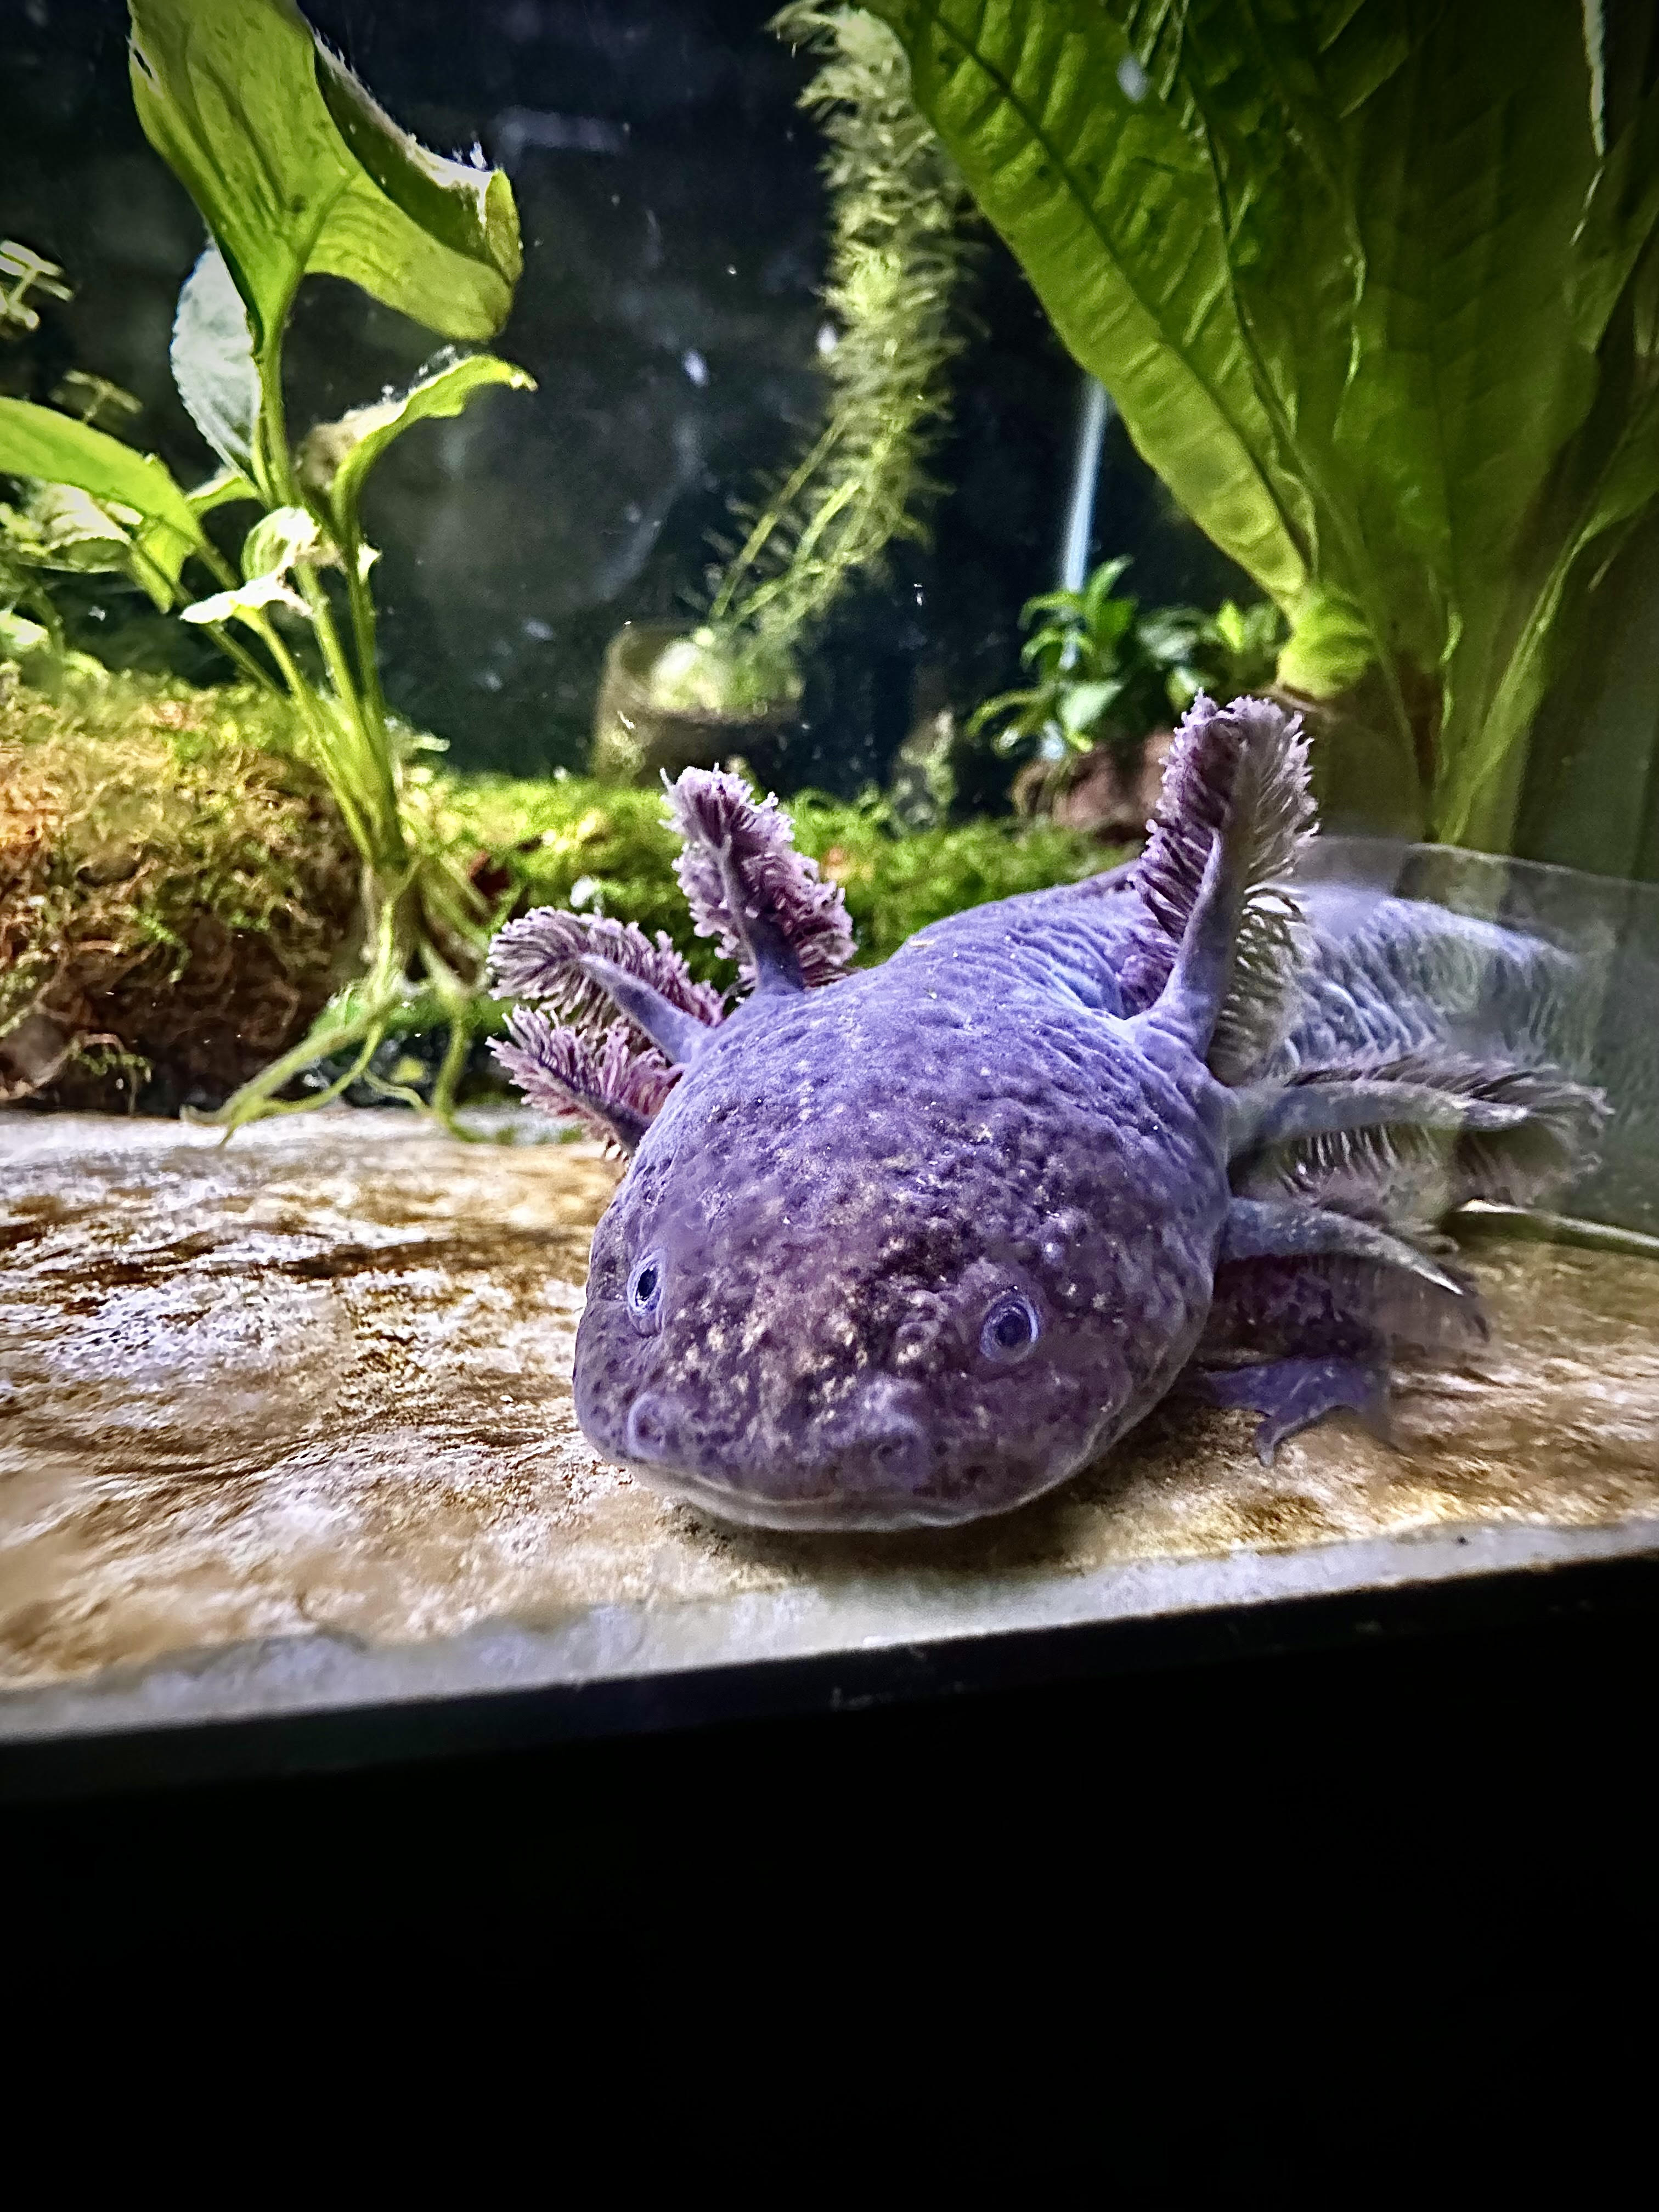
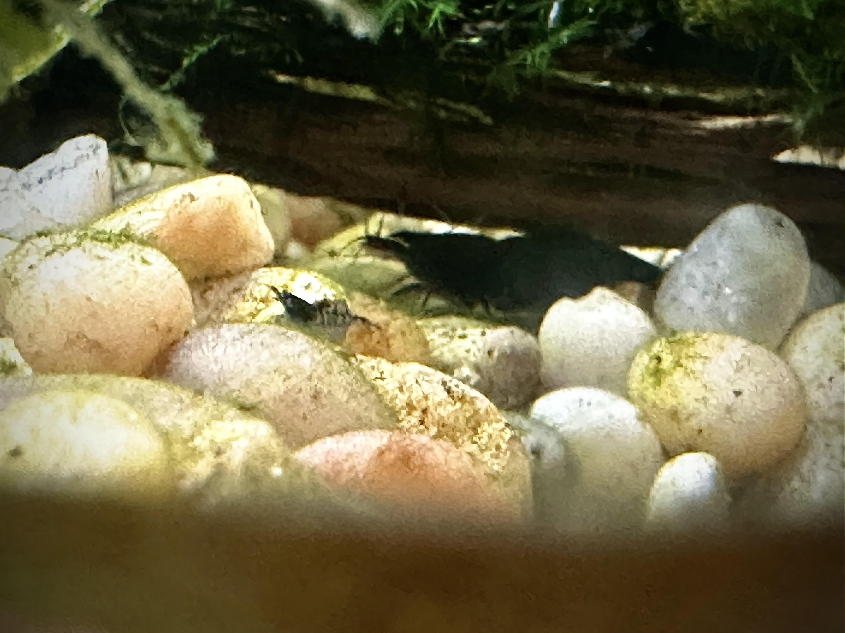

Slide 4
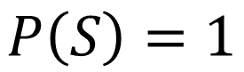
S
$$P\left(S\right)=1$$

Slide 5
S
A’
A

Slide 6
S
A’
A

Slide 7
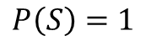
$$P\left(S\right)=1$$

Slide 9
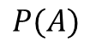
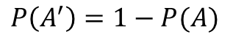
$$P\left(A^{′}\right)=1−P(A)$$
$$P(A)$$

Slide 10
Neither hits a home run
nor steals a base
Hits a home run and steals a base
Hits a home run
Steals a base

Slide 11
Shohei Hotani’s Performance in the Next LA Dodgers Game
Neither hits a home run
nor steals a base
Hits a home run and steals a base
Hits a home run
Steals a base

Slide 12
Shohei Hotani’s Performance in the Next LA Dodgers Game
Neither hits a home run
nor steals a base
Hits a home run and steals a base
Hits a home run
Steals a base

Slide 13
Shohei Hotani’s Performance in the Next LA Dodgers Game
Neither hits a home run
nor steals a base
Hits a home run and steals a base
Hits a home run
Steals a base

Slide 14
Shohei Hotani’s Performance in his Next At Bat
Neither hits a home run
nor steals a base
Hits a home run
Steals a base

Slide 15
Shohei Hotani’s Performance in his Next At Bat
Neither hits a home run
nor steals a base
Hits a home run
Steals a base

Slide 16
Shohei Hotani’s Performance in the Next LA Dodgers Game
Neither makes a hit
nor pitches a strikeout
Makes a hit and pitches a strikeout
Makes a hit
Pitches a strikeout

Slide 17
Shohei Hotani’s Performance in the Next LA Dodgers Game
Neither makes a hit
nor pitches a strikeout
Makes a hit and pitches a strikeout
Makes a hit
Pitches a strikeout

